Slide 1
DATA ANALYST NANODEGREE
Session 5
Conducted by: Hamza
Notes:
https://udacity.zoom.us/j/7991233356
‹#›

Slide 2
AGENDA
Inferential statistics.. Lies!
When not to use inferential statistics!
Project
Conditional probability and bayes rule
Bayesian project
Notes:
‹#›

Slide 3
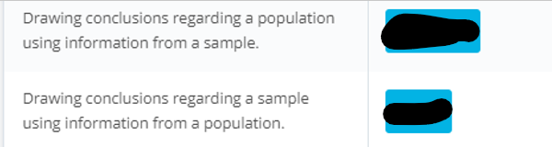
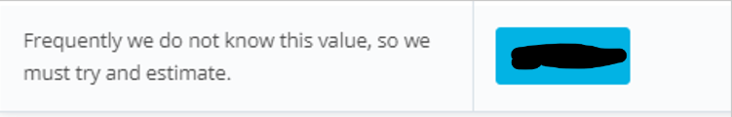
INFERENTIAL STATISTICS

Slide 4
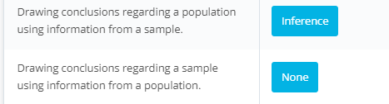
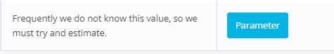
Notes:
Get more examples
‹#›

Slide 5

CONDUCT A STUDY!

Slide 6
WHAT U THINK?
“A statewide antibody study estimates that 21% of New York City residents have had the coronavirus, Cuomo says.”

Slide 7
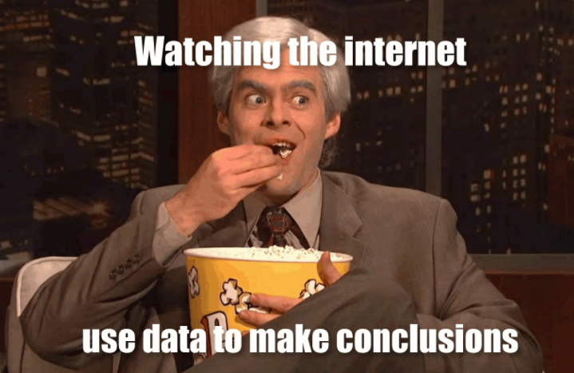
TRUST ☺
Notes:
Ya3ny eh?
If lopsided results are misleading, that doesn’t necessarily mean that they were born out of the intent to mislead. Perhaps they were, perhaps they weren’t. Statistical bias can come about through negligence, ignorance, expediancy, or shenanigans.
‹#›

Slide 8

WHAT IS BIAS?
What’s variance?
Notes:
‹#›

Slide 9
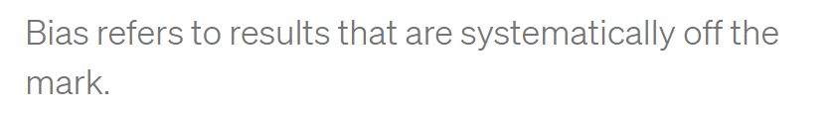
Notes:
High bias doesn’t mean you’re shooting all over the place (that’s high variance), but may cause a perfect archer hit below the bullseye all the time.
‹#›

Slide 10
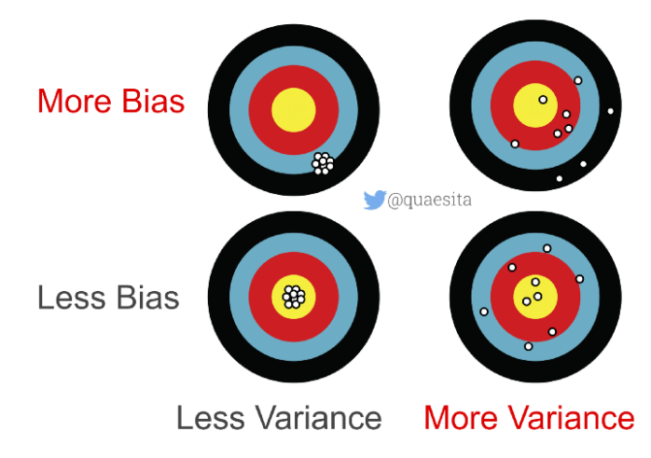

Slide 11
BIAS/VARIANCE? OVER OR UNDER?
“A statewide antibody study estimates that 21% of New York City residents have had the coronavirus, Cuomo says.”
What u think?
Notes:
Over or under estimation?
Over estimation
The true is low
Why? I smell the pungent odor of randomization issues with how the data were obtained, which brings me to statistical subdefinition #2.
‹#›

Slide 12
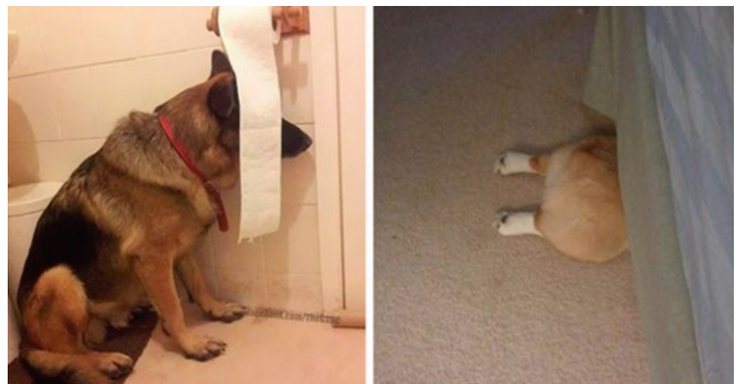
INDOOR?
Notes:
What clever thing did they do to collect data from people who stay indoors?
As it turns out, no clever thing.
‹#›

Slide 13
QUESTIONS TO ASK?
What’s the probability the study measured someone who is fully self-quarantined?
How many NYC residents are keeping themselves entirely to themselves?
Notes:
Zero.
We don’t know.
‹#›

Slide 14
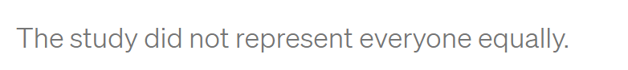
CONCLUSION
Notes:
Selection bias
A special way to trigger results that are systematically off the mark is to collect your data in a problematic manner. For statisticians who love having things to be grumpy about, selection bias is a cherished frenemy. It visits so often!
Selection bias occurs when different members of your population of interest have different probabilities of arriving in your sample.
In other words, you’re making conclusions from your sample as if it were drawn randomly while it was drawn, er, “randomly” instead.
‹#›

Slide 15
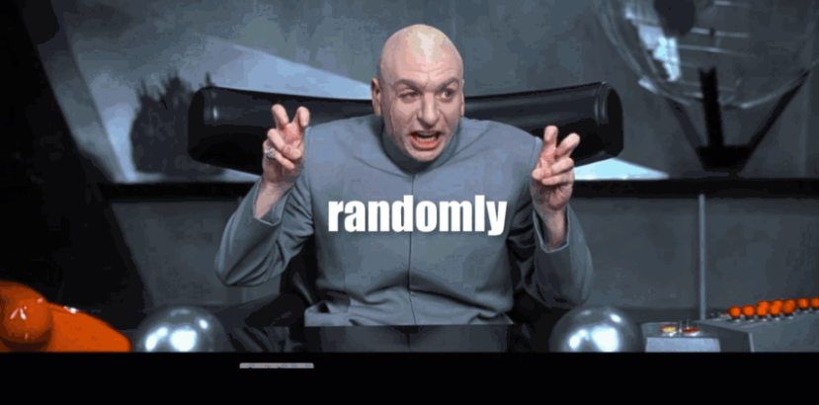
Notes:
In that case, your sample isn’t representative of your population… which makes your conclusions untrustworthy.
If your population of interest is all New York City residents, then you don’t have a random sample (SRS) unless every single New York City resident has equal probability of being included. Is that requirement met by the NY antibody study? Definitely not.
‹#›

Slide 16
UNDERCOVERAGE BIAS
How to solve?
Notes:
‹#›

Slide 17
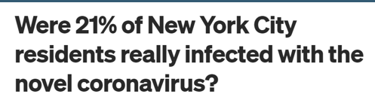
SOLUTION
“all NYC residents who go outside”
Notes:
One pragmatic quick fix for undercoverage bias is to settle for a less ambitious population definition. Instead of trying to make inferences about “all NYC residents” you could choose instead to talk about “all NYC residents who go outside” — problem solved!
‹#›

Slide 18
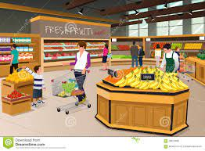
NOW FIXED?
The study tested people “at
grocery and big-box stores.”
Any problem?
Notes:
Let’s see how the data were gathered. The study tested people “at grocery and big-box stores.” If you’d like increase your probability of exposure, where do you go? To places with a higher density of people, like grocery and big-box stores. Where was the study done? Yup.
‹#›

Slide 19
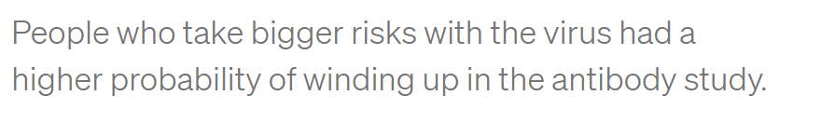
GROCERY FREQUENT VISITS
Notes:
How about if you really, really, really want to get the virus? You might go to grocery and big-box stores frequently… more frequently than someone who’s trying to reduce their probability of infection. Of these two kinds of people, which kind of person would be more likely to have COVID-19 antibodies? Which do you think would be more likely to be in the right place at the right time to participate in the study? Hello, selection bias!
‹#›

Slide 20
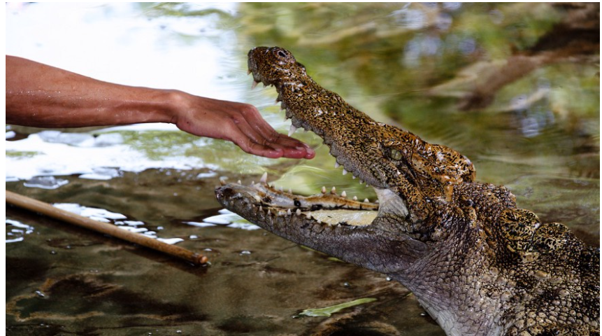
volunteer bias ?
Notes:
volunteer bias because he suspects he was infected, or currently infected
‹#›

Slide 21
HOW TO SOLVE?
Notes:
Biased archers have it easy — if you keep hitting the target above the center, at least you can see it and make adjustments. Researchers with selection bias aren’t so lucky. Selection bias means all your results are wrong and you don’t know how wrong.
‹#›

Slide 22
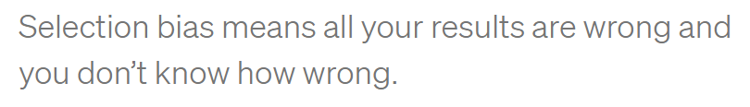
NO SOLUTION ☹

Slide 23

Notes:
Is this enough?
‹#›

Slide 24
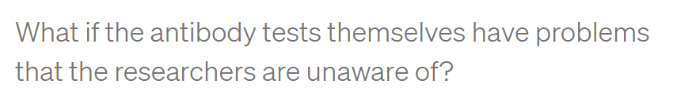
BIASED CONCLUSIONS
PCR sensitivity
threshold
Notes:
information bias occurs when measurements are systematically incorrect.
Have u heard of PCR sensitivity?
What if they only detect antibodies above a strict threshold to avoid false alarms?
‹#›

Slide 25
INFORMATION VS SELECTION
خالصين ؟
Notes:
‹#›

Slide 26
CONCLUSION ABOUT POPULATION?
What do we know about NYC residents’ actual exposure rate?
Notes:
Exposure rate : we know Nothing
‹#›

Slide 27
CONCLUSION ABOUT POPULATION?
What do we know about NYC residents’ actual exposure rate?
- What do we know for sure?
Notes:
What we know for sure?
Some people at grocery and big box stores got an exciting readout from something called an antibody test.
‹#›

Slide 28
BUSINESS INSIDER
“preliminary”
sampling issues
So where is the problem?
Notes:
To be fair to Business Insider, I think they did a pretty good job of reporting. They even called the results “preliminary” and mentioned some of the same sampling issues I talked about. Kudos! These are the same properly-cautious noises originally made by the governor of NY and the team who ran the study. I have no beef with them either. Instead, my complaint is with the broken telephone game that the rest of the internet is playing.
‹#›

Slide 29
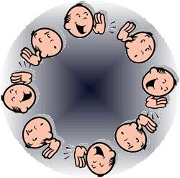

WHAT IS THE PROBLEM?
Soret el telephone el 5arban
Notes:
Instead, my complaint is with the broken telephone game that the rest of the internet is playing.
‹#›

Slide 30

MOST COMMON
1- Read all article?
2- say I haven’t read
3- report the title only?
Notes:
What most frequently occurs on whatsapp?
Report the title only.
‹#›

Slide 31
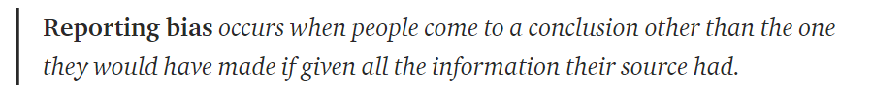
REPORTING BIAS

Slide 32
WHEN REPORTING BIAS HAPPENS?
Journal club?
Twitter?
Trick
Feel better
Advertising a scientific article
Notes:
Make pithy summaries of complicated things (e.g. to squeeze everything into a 280 character tweet).
Prevent readers’ eyes from glazing over (e.g. journalists editorializing scientific publications).
Persuade someone through trickery (e.g. conveniently “forgetting” to mention studies that cast doubt on the arguments you’re hoping to make).
Feel better about their opinions (e.g. when they’re suffering from confirmation bias).
‹#›

Slide 33
IS THE STUDY WORTHLESS?
Notes:
Does this mean that the study is worthless? No, but it’s only as good as the assumptions you’ll make about it. Since there’s very little that we know for sure from its data, the only way to make inferences beyond the facts is to bridge the gap with assumptions. That’s all statistics is. Assumptions, not magic.
Unfortunately, we’re not all equally qualified to make good assumptions that lead to useful conclusions. For example, while I am a statistician with plenty of real-world data collection experience, I’m not an expert in antibody tests, so you shouldn’t trust me to make wise assumptions about their accuracy. Excellent! I don’t trust me either, so I’ll end up learning nothing about the virus exposure rate of NYC. The study is worthless in my hands.
‹#›

Slide 34
IS THE STUDY WORTHLESS?
As good as the assumptions
Notes:
Does this mean that the study is worthless? No, but it’s only as good as the assumptions you’ll make about it. Since there’s very little that we know for sure from its data, the only way to make inferences beyond the facts is to bridge the gap with assumptions. That’s all statistics is. Assumptions, not magic.
Unfortunately, we’re not all equally qualified to make good assumptions that lead to useful conclusions. For example, while I am a statistician with plenty of real-world data collection experience, I’m not an expert in antibody tests, so you shouldn’t trust me to make wise assumptions about their accuracy. Excellent! I don’t trust me either, so I’ll end up learning nothing about the virus exposure rate of NYC. The study is worthless in my hands.
‹#›

Slide 35
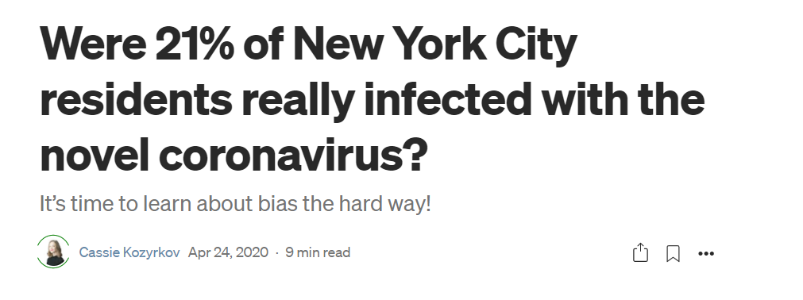
Notes:
Were 21% of New York City residents really infected with the novel coronavirus? | by Cassie Kozyrkov | Towards Data Science
https://towardsdatascience.com/were-21-of-new-york-city-residents-really-infected-with-covid-19-aab6ebefda0
‹#›

Slide 36
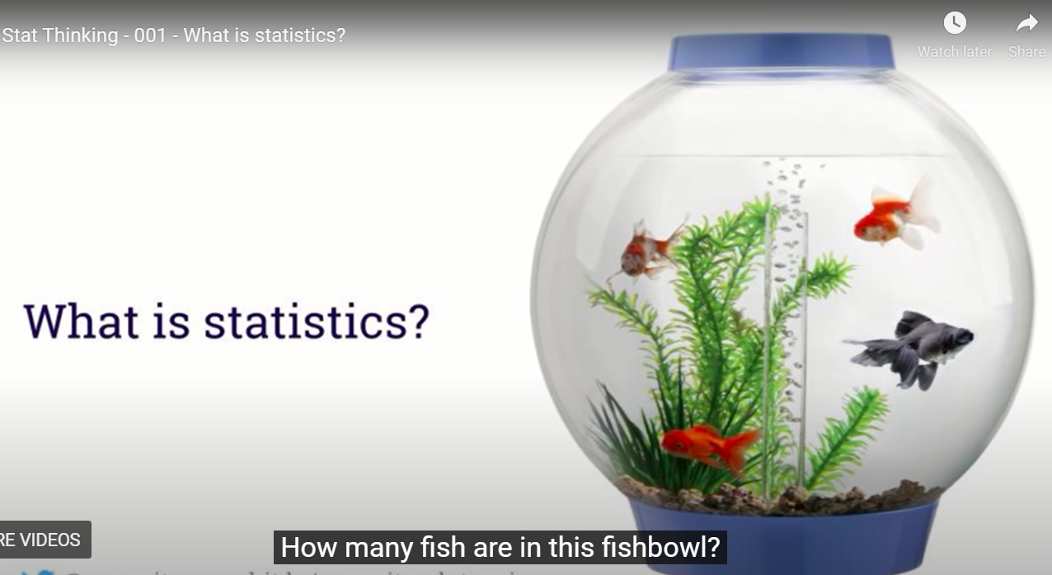
WHEN NOT TO USE STATISTICS?
Notes:
Let’s call them goldfish
‹#›

Slide 37
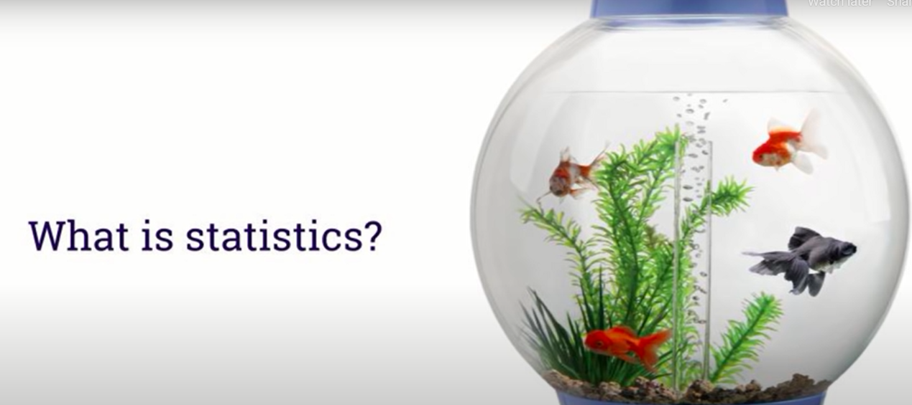
DIFFERENT COLORS?
Notes:
Can gold fish in general have different colors?
‹#›

Slide 38
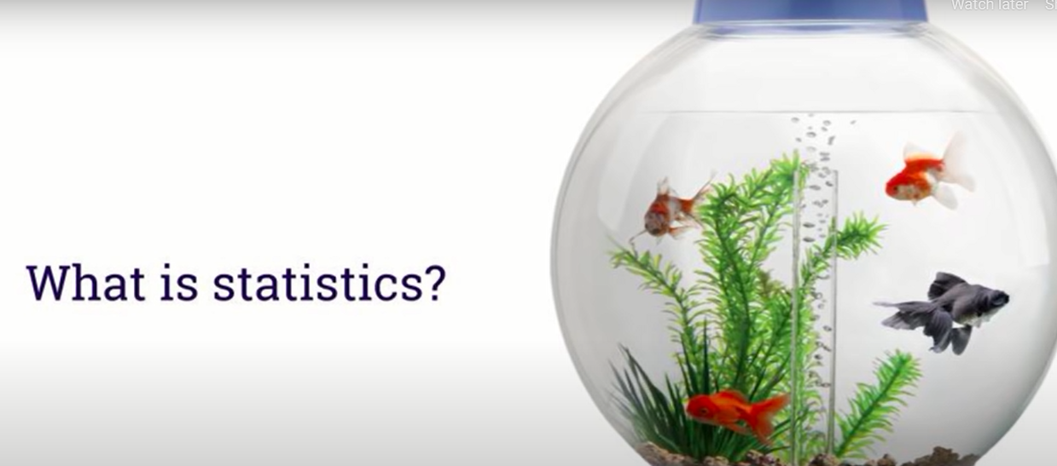
GOLD .. NOT GOLD?
Notes:
Can a gold fish have a non-gold color ? Yes
‹#›

Slide 39
Are these questions about data?

Slide 40
Are these questions about data?
Yes
Are these questions about inferential statistics?

Slide 41
Are these questions about data?
Yes
Are these questions about statistics?
No!

Slide 42
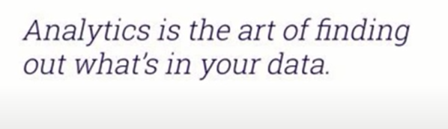
GOING BEYOND THE DATA?
Notes:
Sine we are describing our dataset, that’s data mining or analytics or descriptive statistics
‹#›

Slide 43
DIFFERENT COLORS?
Why not stats?
Notes:
Because u are certain about the answer
‹#›

Slide 44
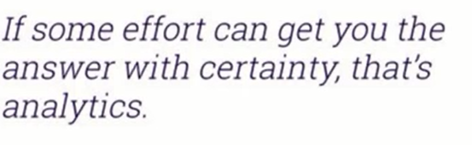
DIFFERENT COLORS?
Notes:
‹#›

Slide 45
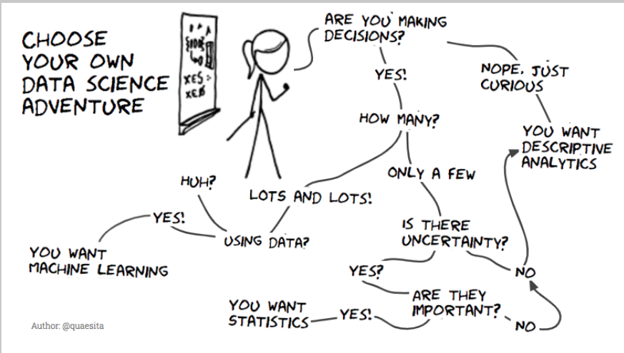
Notes:
Is there uncertainty?
‹#›

Slide 46
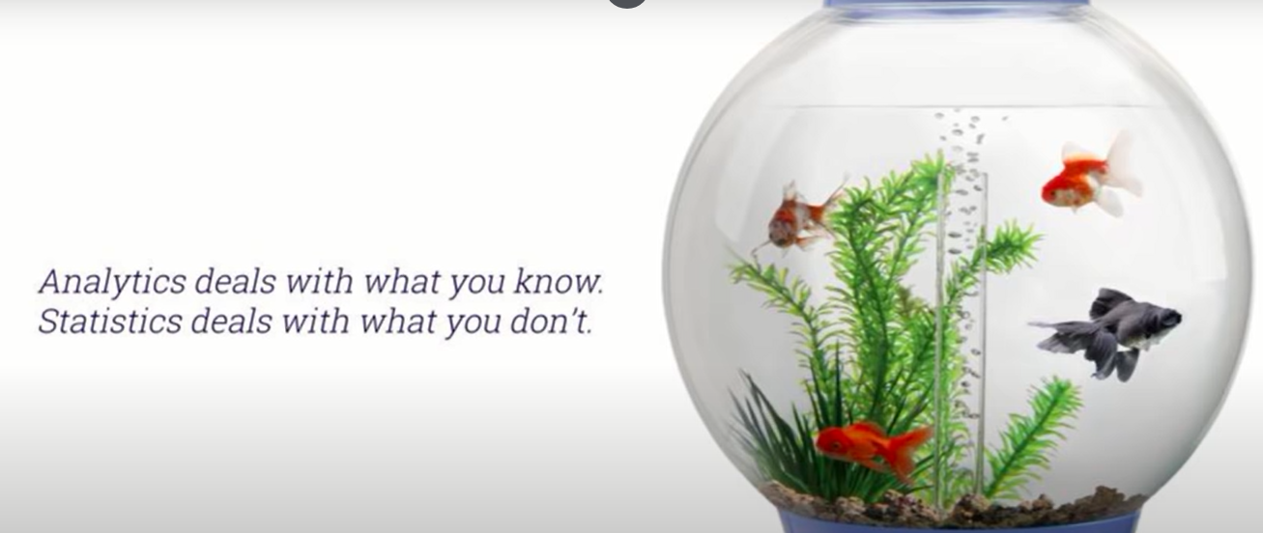
STATISTICS VS ANALYTICS

Slide 47
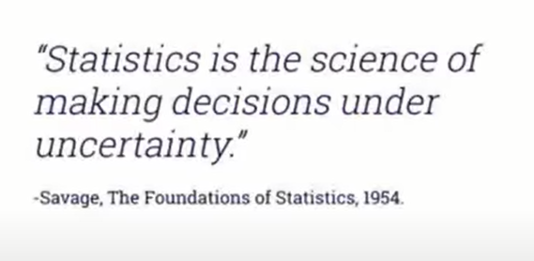
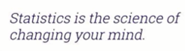
STATISTICS

Slide 48
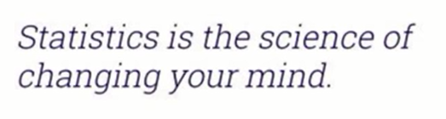
MY MIND?

Slide 49
MY MIND?
Prior belief
Default action
Notes:
‹#›

Slide 50
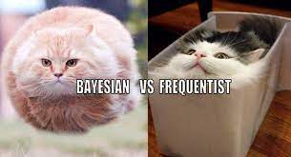
MY MIND?
Prior belief
Default action
Notes:
‹#›

Slide 51
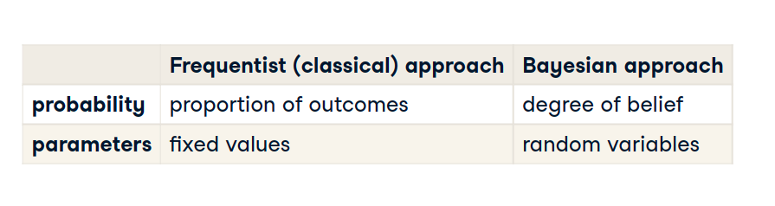

Slide 52

PHD STATISTICS
Notes:
U don’t want to have PhD in stats without knowing when to use statistics
‹#›

Slide 53
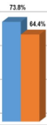
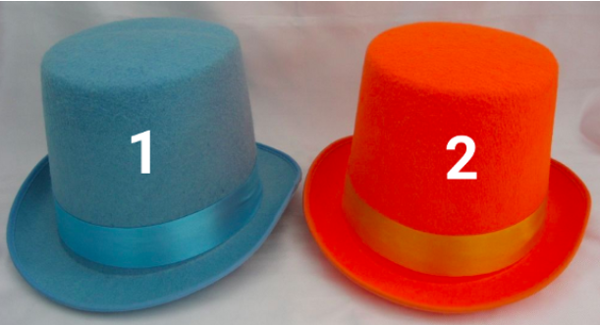
INDIFFERENT
Notes:
If you’re indifferent between these hats to begin with and you get more votes for blue than orange, there’s no math in the world that should tell you to pick orange. Math isn’t magic and it doesn’t violate common sense.
‹#›

Slide 54
WHEN TO CHOOSE ORANGE?
Notes:
The only way it makes sense to end up choosing blue is if you had a preference for the blue hat to begin with. Then you’re asking whether the evidence in favor of orange is strong enough. In other words, whether there’s enough data to change your mind. Okay, so how can you tell?
‹#›

Slide 55
INDIFFERENT
Do I need statistics?
Notes:
No!!!
Don’t waste ur time
‹#›

Slide 56
INDIFFERENT
What if I am wrong?
Notes:
“But it could be wrong!” Of course it could be wrong, that’s what it means to be uncertain. There’s no mathemagic in the world that can make certainty out of uncertainty. Your best guess might be a mistake, but it is your best guess, which makes any other guess a worse guess and even more likely to be wrong.
‹#›

Slide 57
WELCOME TO UNCERTAINTY
What if I am wrong?
Notes:
“But it could be wrong!” Of course it could be wrong, that’s what it means to be uncertain. There’s no mathemagic in the world that can make certainty out of uncertainty. Your best guess might be a mistake, but it is your best guess, which makes any other guess a worse guess and even more likely to be wrong.
‹#›

Slide 58
INDIFFERENT
0.001 difference?
Notes:
Msh far2a
This is ur best guess
‹#›

Slide 59
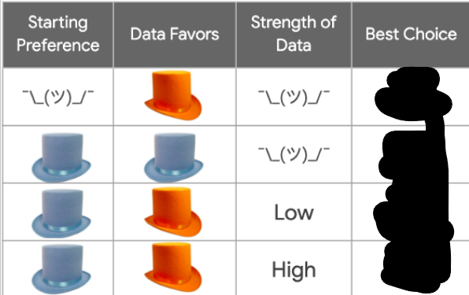
WHAT TO CHOOSE?

Slide 60
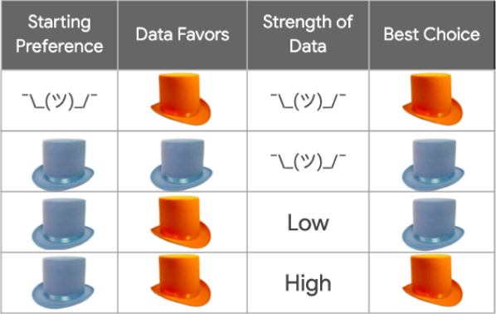

Slide 61
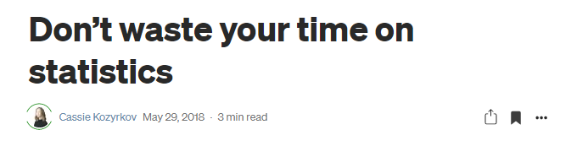
Notes:
Don’t waste your time on statistics | by Cassie Kozyrkov | Towards Data Science
https://towardsdatascience.com/whats-the-point-of-statistics-8163635da56c
‹#›

Slide 62
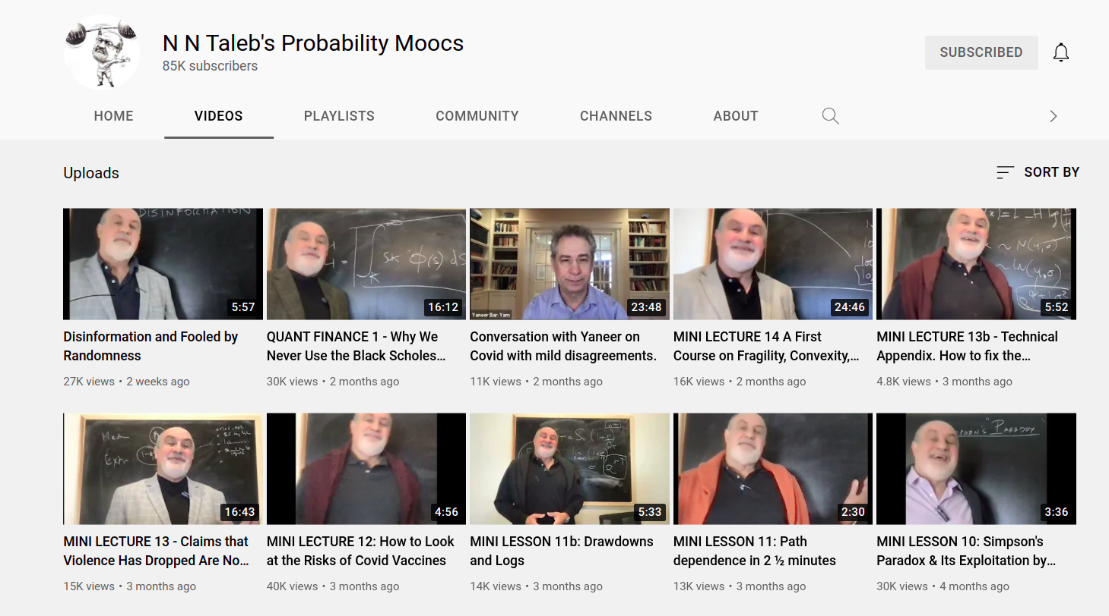

Slide 63
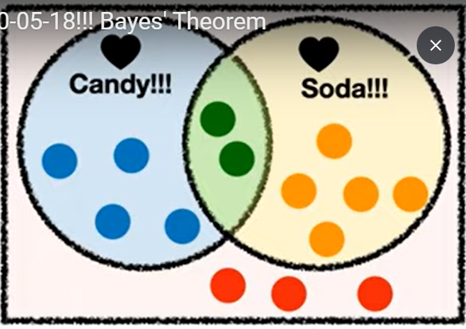
BAYES

Slide 64
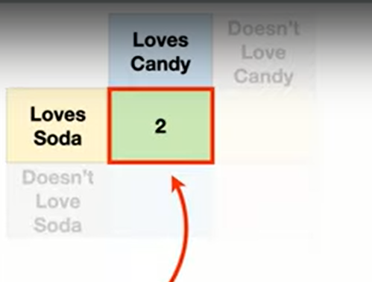

Slide 65
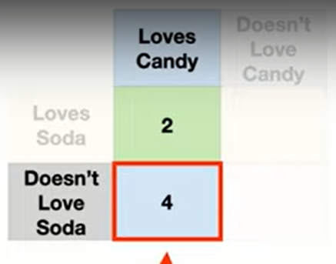

Slide 66
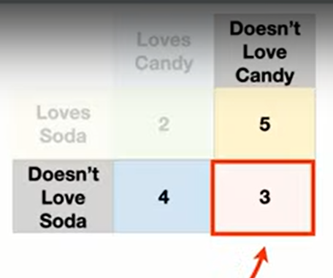

Slide 67
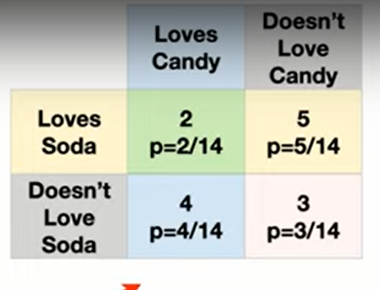

Slide 68
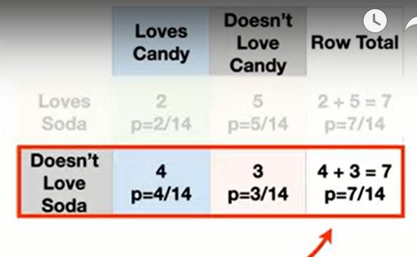

Slide 69
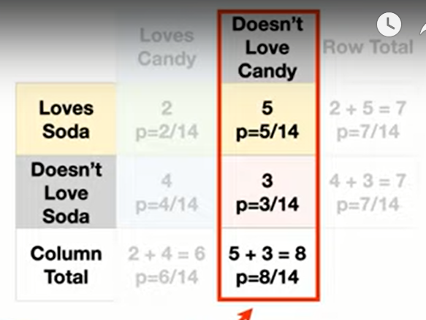

Slide 70
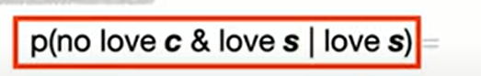
`

Slide 71
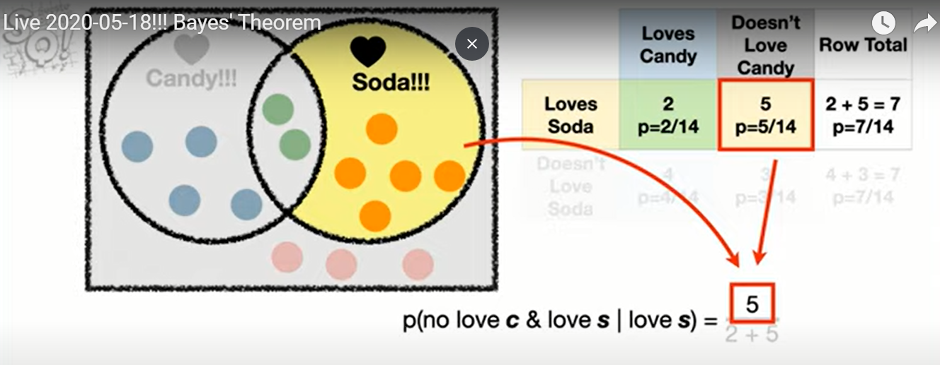

Slide 72
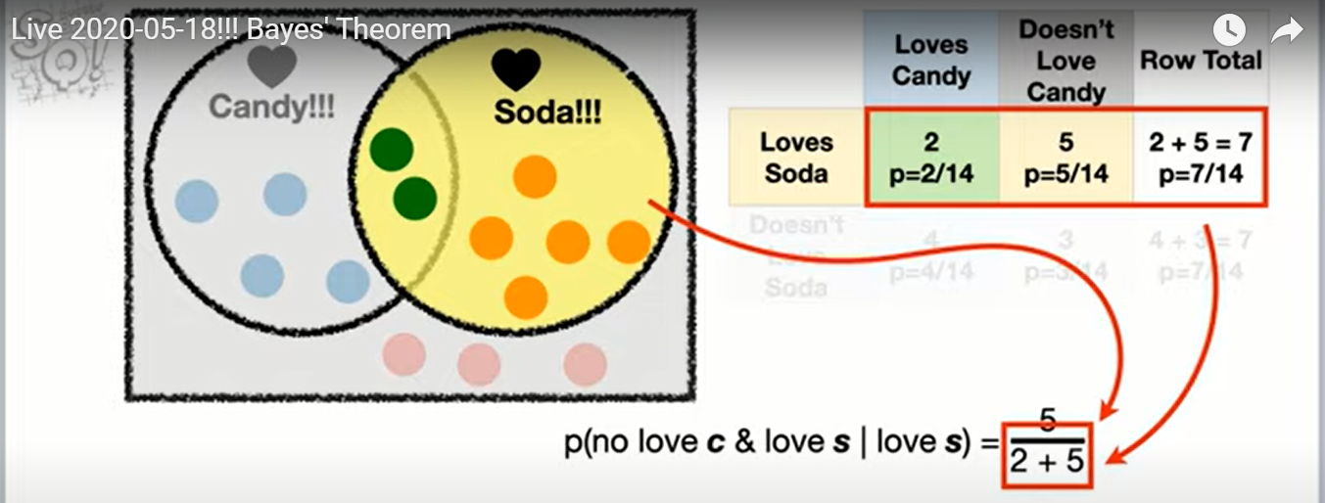

Slide 73
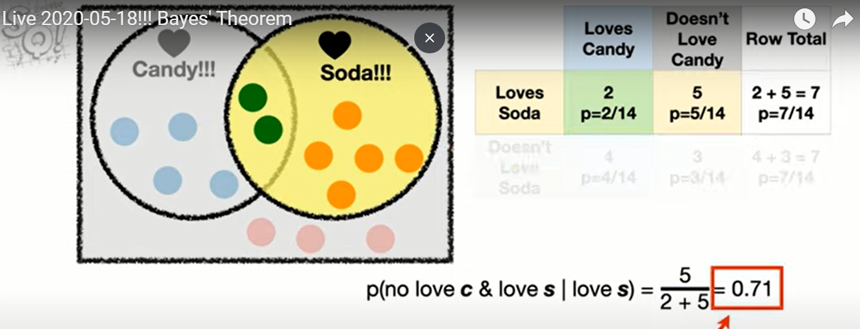

Slide 74
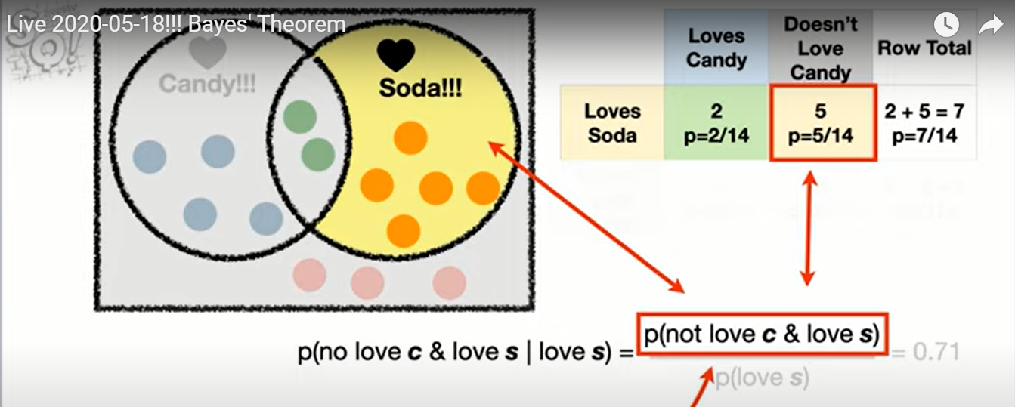

Slide 75
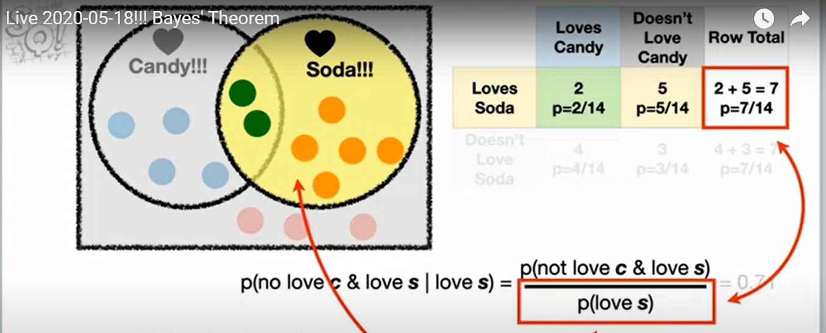

Slide 76


Slide 77


Slide 78

Any redundancy?
Notes:
‹#›

Slide 79


Any redundancy?
Notes:
‹#›

Slide 80
LOVE REDUNDANCY ☺
Any redundancy?
Notes:
‹#›

Slide 81
TRY IT YOURSELF
P(love c | no love s)
Notes:
‹#›

Slide 82
SOLUTION
P(love c | no love s) = 4/7
Notes:
‹#›

Slide 83

Notes:
Bayes theorem is not a big deal
‹#›

Slide 84

That easy?

Slide 85


Slide 86

MORE INFO?
Notes:
https://statquest.org/bayes-theorem-clearly-explained/
‹#›

Slide 87
BAYES EXERCISE
A case study with Conditional probability | Kaggle
https://www.kaggle.com/lakshya91/a-case-study-with-conditional-probability
Check notebook
Check dataset
Explore kaggle

Slide 88

PROJECT

Slide 89




Slide 90
https://review.udacity.com/#!/rubrics/1214/view
Notes:
‹#›

Slide 91
ALTERNATIVE SOLUTION
Notebooks for udacity exercises
check github

Slide 92
Breakout rooms
check github

Slide 93

BOMB ON PLANE
Notes:
humor - What is your favorite "data analysis" cartoon? - Cross Validated
https://stats.stackexchange.com/questions/423/what-is-your-favorite-data-analysis-cartoon/38295#38295
But if you know that "there is a bomb" (yours) in the plane, which we may call event AA, and you are willing to accept that the "existence of a second bomb" (event BB) is independent of AA, then P(B∣A)=P(B)=1/1000P(B∣A)=P(B)=1/1000. Always condition on what you know. And yeah, I deserve a −1−1 for screwing a good joke
‹#›

Slide 94


Slide 95

IMPORTANCE OF DISTRIBUTION OR CONDITIONAL PROBABILITY
Notes:
Greetings new recruits! Welcome to the training camp for gladiators
Be warned! One in three of you does not survive the training
33.3% ... That's not so bad
humor - What is your favorite "data analysis" cartoon? - Cross Validated
https://stats.stackexchange.com/questions/423/what-is-your-favorite-data-analysis-cartoon/38295#38295
As a pointer to why we should think about conditional probabilities (and from then on, to why tools like logistic regression are useful for predicting risk) this is an excellent cartoon.
‹#›

Slide 96

https://www.bayesrulesbook.com/

Slide 97


Slide 98


Slide 99


Slide 100

Notes:
‹#›

Slide 101

Notes:
Can’t answer!!!
We need the prevalence
True for positive predictive value
‹#›

Slide 102
MY MIND?
Prior belief
Default action
Notes:
‹#›

Slide 103
HOW COMMON IS THE DISEASE?
Prevalence
1%

Slide 104

Notes:
Are they of equal importance to me?
Which one u thing is the false positive ?
‹#›

Slide 105


IS THIS GOOD?
Notes:
Maybe it’s not bad
Maybe we need this test to exclude, and if we have false positive, we can head to a better test with higher specificity
‹#›

Slide 106


Slide 107

Notes:
Conditional Probability Explained: Visual Intuition - YouTube
https://www.youtube.com/watch?v=by3_weGwnMg
‹#›

Slide 108

HEART OF BAYES THEOREM?
Notes:
Base Rate Fallacy - Biases & Heuristics | The Decision Lab
https://thedecisionlab.com/biases/base-rate-fallacy/
‹#›

Slide 109

مدينة السمبلاوين
85% are blue and 15%
are green.
Notes:
Example 1 - The cab problem
This classic example of the base rate fallacy is presented in Bar-Hillel’s foundational paper on the topic.¹¹ First, participants are given the following base rate information. There are two cab companies in a city: one is the “Green” company, the other is the “Blue” company. The names of the company refer to the colors of their respective taxis. It is specified that, of all the cabs in the city, 85% are blue and 15% are green.
‹#›

Slide 110



HIT AND RUN
Notes:
Then, a scenario is described in which a cab, which a witness later identifies as green, was involved in a hit and run one night.
‹#›

Slide 111

PROBABILITY THAT HIT WAS BY GREEN CAR?
witness can accurately distinguish the colors 80% of the time but confuses them 20% of the time
Notes:
In order to assess the reliability of the witness, the court ordered that their ability to discriminate between blue and green cabs at nighttime be tested. It is shown that the witness can accurately distinguish the colors 80% of the time but confuses them 20% of the time. Participants are then asked to give the likelihood that the cab involved in the hit and run was actually green.
‹#›

Slide 112
BASE RATE NEGLECT
85% are blue and 15%
are green.
P(witness correct) = 41%.
Notes:
Many people are inclined to respond that the probability that the witness correctly identified a green cab at night is 80%. However, everyone who gives that answer is committing the base rate fallacy. When taking into account the base rate information, which tells us that only 15% of the cabs in the city are green, the actual probability that the witness was correct is 41%. This probability is achieved through inferential statistics calculations, which take into account both the percentage of each color cab in the city and the likelihood that the witness correctly discriminated between the colors at night.
‹#›

Slide 113

RULE 1
Notes:
U focused on likelihood (results) that tom is shy
And forgot about prior, number of students in each major
This is very common and it is called “bayes rate neglect”
‹#›

Slide 114

Notes:
What’s the probability that if he left the kitchen and took a look of the balcony that he will come back and kidnap the kids?
‹#›

Slide 115


Slide 116

SHOULD HAVE THIS EFFECT

Slide 117

Why 80:10 - why 1:100?
Notes:
Sure u can take precautions
But it totally differs if u are taken precautions because something will happen for sure
Or if u know it is still not common ( so u won’t freak out) and u still take the precautions
‹#›

Slide 118

Notes:
Are people expected to know the probability of a repair’s man being a robber? No
‹#›

Slide 119

THE QUESTION IS:
Notes:
Did u consider it?
Rationality is not about knowing facts
It’s about knowing which facts are relevant
‹#›

Slide 120


HOW TO DEAL WITH INFO?
Notes:
Bob is jealous from amy
The likelihood: one time amy didn’t finish a project she was assigned
Bob is complaining about amy not finishing the project
‹#›

Slide 121


Slide 122

WHAT IF NOT JEALOUS?
Notes:
If he wasn’t jealous, there is still a high probability that he would complain about her
‹#›

Slide 123

UPDATE RATIONALLY

Slide 124

RULE 2

Slide 125


Slide 126

WHAT U THINK?
Notes:
‹#›

Slide 127
NEW DATA
A smart friend tells u meditation is useful
What to do?
Notes:
‹#›

Slide 128

UPDATE A BIT!
It depends
Notes:
Depends on ur prior.. Were u sure that meditation was fake?
Is ur friend related to meditation?
Apart from being smart? Do u trust him?
‹#›

Slide 129


MORE AND MORE INFO?

Slide 130

3 RULES

Slide 131

WANT MORE INFO?
Notes:
A visual guide to Bayesian thinking - YouTube
https://www.youtube.com/watch?v=BrK7X_XlGB8
‹#›

Slide 132
HEART OF BAYES’ THEOREM?
???

Slide 133

The medical test paradox, and redesigning Bayes' rule - YouTube
https://www.youtube.com/watch?v=lG4VkPoG3ko

Slide 134


Slide 135

MAYBE WE DIFFER
Notes:
But how we update our beliefs is what really matter
‹#›

Slide 136

Notes:
More precise calculate using calculus or a computer
‹#›

Slide 137

Notes:
StatQuest: What is a statistical distribution? - YouTube
https://www.youtube.com/watch?v=oI3hZJqXJuc
‹#›

Slide 138


HOW TO CHOOSE?
Why to choose?
Notes:
Normal
Binomial
Exponential
Gamma
Pdf
Pmf
‹#›

Slide 139

PAUSE A MINUTE

Slide 140

PAUSE A MINUTE

Slide 141

IS THE STUDY WORTHLESS?
As good as the assumptions
Notes:
Does this mean that the study is worthless? No, but it’s only as good as the assumptions you’ll make about it. Since there’s very little that we know for sure from its data, the only way to make inferences beyond the facts is to bridge the gap with assumptions. That’s all statistics is. Assumptions, not magic.
Unfortunately, we’re not all equally qualified to make good assumptions that lead to useful conclusions. For example, while I am a statistician with plenty of real-world data collection experience, I’m not an expert in antibody tests, so you shouldn’t trust me to make wise assumptions about their accuracy. Excellent! I don’t trust me either, so I’ll end up learning nothing about the virus exposure rate of NYC. The study is worthless in my hands.
‹#›

Slide 142
HOW TO CHOOSE?
Why to choose?
Notes:
Normal
Binomial
Exponential
Gamma
Pdf
Pmf
‹#›

Slide 143

لولو من أبولو
Notes:
‹#›

Slide 144

IT DIFFERS
Notes:
List of Probability Distributions - Stat Mania English
http://en.statmania.info/2015/08/list-of-probability-distribution.html
‹#›

Slide 145
CHOOSING YOUR DISTRIBUTION
1- assume a distribution
2- other solutions (to be continued …)
Notes:
They either (1) estimate empirical distributions from their data — using, you guessed it, histograms! — or they (2) make theoretical assumptions about which member of a popular distribution catalog looks most similar to how they believe their data source behaves.
3) Kernel density without assumptions
MLE or method of moment
Or kernel density estimation
Or use bootstrap
I need to read Tom’s lectures
‹#›

Slide 146

WHICH DISTRIBUTION?

Slide 147

POPULAR DISTRIBUTIONS
Notes:
On the plus side, named distributions come with neat PDFs and a bunch of calculations pre-done for you.
On the minus side, your application might not fit anything in a catalog. Thanks for the empirical option.
For the empirical, I think it may be hard to generalize.
Many items, ex. Bin size can make results unpredictable
Check the medium article
‹#›

Slide 148



WHY DO I NEED A DISTRIBUTION?
Notes:
Imagine u r in an algebra exam.
U have a formula sheet
W see the questions and u want to answer ..
What to do?
Check the questions and see which one of them fits in ur sheet
Then answer
Or u can invent or derive a formula
Which needs time, validation, etc..
‹#›

Slide 149

WHY WAIT?
Notes:
If we have our data, and we have assumed a popular distribution. Why not start plotting?
Let’s be honest — the insights aren’t exactly leaping off the page. That’s why we tend to prefer asking questions about specific parameters of interest to us. In statistics, parameters summarize populations or distributions. For example, if you’re asking whether the distribution peaks at zero, you’re asking about the location of its mode (a parameter). If you’re asking how fat the distribution is, you’re asking about its variance (another parameter). In a moment, I’ll take you on a tour of a few of my favorite parameters.
‹#›

Slide 150

WITHOUT PARAMETERS ☺
Notes:
If you look at the function above, you’ll notice that there are some Greek letters in there: μ and 𝜎.*** These are special parameters for this distribution; until we replace them with numbers, we’re not ready to plot anything. Without them, all we can do is get a vague sense of the abstract shape of the distribution, like so:
‹#›

Slide 151
لولو من أبولو
Notes:
Aren’t all of these are normal distributions?
‹#›

Slide 152

NORMAL DISTRIBUTION
http://shiny.calpoly.sh/Prob_View/
Notes:
There’s plenty more Greek to enjoy, since other distributions use other characters for their special quantities.
‹#›

Slide 153
PAUSE A MINUTE

Slide 154

MORE INFO?
This is part 1
Notes:
Getting to know probability distributions | by Cassie Kozyrkov | Mar, 2021 | Towards Data Science
https://towardsdatascience.com/getting-to-know-probability-distributions-cc1dd1e2f22b
‹#›

Slide 155

THEME

Slide 156

NORMAL DISTRIBUTION

Slide 157

VISUALIZE
https://istats.shinyapps.io/NormalDist/

Slide 158
REAL LIFE EXAMPLE
View data locally (R studio)
Notes:
Zprojects/ran/starting 2020-2-15/requiredanalysisforpatientcost/new_tasks.Rmd
‹#›

Slide 159
WHY SO IMPORTANT?
Statistical tests visualized (Local pdf )

Slide 160

Notes:
which_test_flowchart.png (6131×2669)
https://onishlab.colostate.edu/wp-content/uploads/2019/07/which_test_flowchart.png
‹#›

Slide 161

DOES IT REALLY MATTER?
P value parametric: 0.04
P value non par. : 0.63
Notes:
Look at mean and median for both males and female
Look how females are right skewed
GraphPad Prism 9 Statistics Guide - The Mann-Whitney test doesn't really compare medians
https://www.graphpad.com/guides/prism/latest/statistics/stat_nonparametric_tests_dont_compa.htm
‹#›

Slide 162



NORMALITY TESTS

Slide 163
CAN WE AVOID THIS ASSUMPTION?
See you next week

Slide 164
The medical test paradox, and redesigning Bayes' rule - YouTube
https://www.youtube.com/watch?v=lG4VkPoG3ko

Slide 165

LEFTHANDED PROJECT
https://www.datacamp.com/projects/479

